Slide 1

Using the Coach Approach to support people who are ‘resisting’ change

Slide 2

We ‘resist’ change In four key areas, because it deeply unsettles us
Relationships
Security
Status
Control

Slide 3
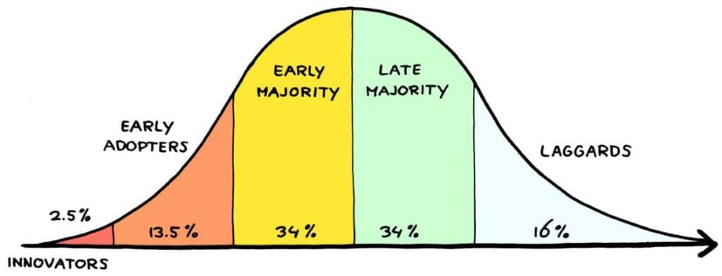
Diffusion of Innovation Curve

Slide 4
William Bridges Transition Theory
The first stage is an Ending, then we move into the ‘transition zone’, or wilderness…which is scary, exciting, confusing, we might miss what we lost, or be impatient for the ‘new’.
At some point, we reach the Beginning, and have integrated the change.

Slide 5

Change vs. Transition
Change is external
Transition is internal/psychological - and can take longer for some people than others
It is the transition period that requires our attention and support, in order that real change can happen. Reduce threat and increase awareness of, and focus on, rewards.

Slide 6
Much of what is termed resistance to change is the struggle people have, individually and collectively, with reorganizing their sense of identity, meaning, values, and sense of possibilities.
They’re not resistant. They’re struggling with an inner journey.
- Eric Klein, Resistance Free Change

Slide 7
Supporting the Transition Phase
Regular and honest communication
How are you…how is it going? (check in/coach)
Allowing time to assess and develop
Training and support
Remind people that change, planned and unplanned, is a regular part of life – individuals and teams can usefully reflect on when they have successfully coped with change in the past, and what helped them to do so.
What do you need from me? From the team? What will you do for yourself?

Slide 8
What is CLEAR?
C ontract
L isten
E xplore
A ction
R eview

Slide 9
Sharing useful questions
For use around ‘change’
For use with ‘resistors’

Slide 10
C.I.A.
The more we feel in control, the more resilient we are…so when we feel overwhelmed, or anxious, our resilience – and potentially our general wellbeing – is adversely impacted.
Step One: self awareness. Identify feelings and put them into words – verbally or in writing.
Step Two: identify aspects of the issue – what can you control or influence, and what must you simply accept? Focus your action/energy on what you can influence or control.

Slide 11
In coaching pairs – 30 minutes
Use this as an opportunity to practice using CLEAR, being present, listening deeply while on screen.
Contract: Thinking about the ‘change’ issue you brought with you today - I encourage you to use the CIA frame to think through the issue, and what you might do differently after thinking through things in this way, today?
What is your step toward better?

