Slide 1
Meaningful and measurable personal outcomes : SWS SDS Group 7.9.17
Emma Miller Consultancy
Also University of Strathclyde

Slide 2
1) Talking about
2) Recording
3) Measuring
4) Using information about
PERSONAL OUTCOMES – 4 components?
outcome
Inputs
output
process
Cook and Miller 2012

Slide 3
Talking Points: outcomes defined by people using services
Process ➔ | Change ➔ | Quality of life ➔
Listened to Having a say Respected Responded to Able to rely on services | Improved confidence Improved skills Improved mobility Reduced symptoms | Feeling safe Having things to do Seeing people As well as can be Life as want (including where you live)
Cook and Miller (2012)
Notes:
3
We usually think about 3 components to a POA – conversation, recording and use of informattion. Here we are going to focus on frontline practice. However, it should be noted that there is a need for a feedback loop between practice and information use

Slide 4
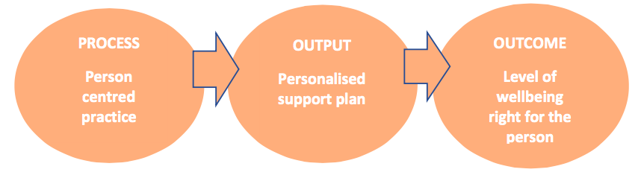
A blueprint for a person centred system of assessment and support planning, Colin Slasberg
Core purpose: assessing for wellbeing rather than eligibility
Four principles of person-centred assessment and support planning:
Needs led Self directed Strengths based Cost effective

Slide 5
1. Conversations about personal outcomes
What do we know about the benefits
Being listened to makes a difference in itself
Being responded to and involved in decision-making can restore confidence and trust and clarify thinking
Good conversations can reduce anxiety and instill hope. They also help people to identify their own solutions
Clarifying priorities through conversation means more effective resource use
(Miller and Barrie, 2016, Meaningful and Measurable)
?Needs led Self directed Strengths based Cost effective

Slide 6
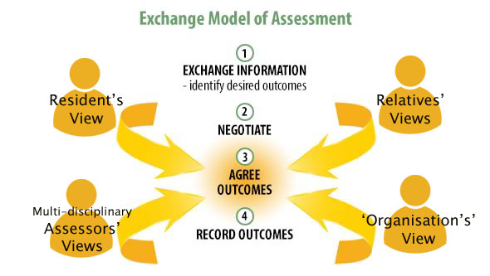
Notes:
Problem:
The main focus to date has been on eliciting the resident’s view and the desired outcomes – or possibly finding a substitute for conversation – This has been at the expense of looking at this process of negotiation and the complexity involved, or recording outcomes… or indeed working towards outcomes and the challenges staff experience on the ground….
Work was opportunity to explore this

Slide 7
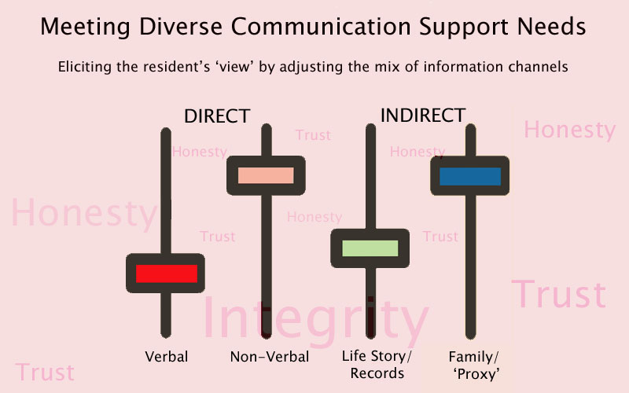
“Let’s Talk”: Meeting Diverse Communication and Decision Making Support Needs:
Notes:
Understanding what matters may include being attentive to life stories, proxy accounts, records and more embodied ways of signifying.
From verbal (e.g. Jim) to non-verbal
Honesty trust integrity added by staff ….
We always use different channels –just a case of adjusting the mix –
Use this with staff to support thinking about key sources of information relied on at present….
Does everybody know these things? What would happen if you weren’t there? Who else neds to know?

Slide 8
“Let’s Talk”: A different kind of conversation
  “We have one woman who was a professional dancer. She has Parkinson’s…. You don’t want to put people into equipment if they can walk. You want to maintain their mobility. So that’s what we do. We move as if we are dancing with her. We walk alongside her and she charges ahead. And that’s something that people don’t know that she does and I’m thinking I should go back and say can we get that written down somewhere so people know that’s a good way to work with her” (session 2 – ER)
  Drawing on examples from the doctoral thesis: Developing the Conceptual Underpinnings of Relationship Centred Palliative Dementia Care, Dr. Julie Watson, 2015
Notes:
These are just a couple

Slide 9
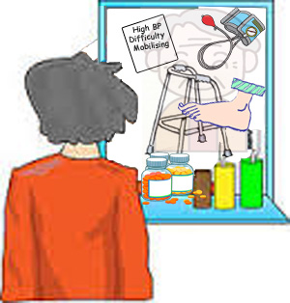
2. Recording Personal Outcomes ~ What to Look for
Outcomes Vs Outputs: Clear distinction between what matters to and difference for the person Vs ‘tasks’
It’s about all of us:
is the person contributing to outcomes?
is the family role identified?
are other resources identified alongside care home staff ?
Strengths and capacities of the person, not just deficits
A story the person would recognise (uses their own ‘language’)
Gets beyond the high level or general to the personal
Future action oriented (usually) - specifies what is to happen to achieve outcomes, by whom and when
Notes:
The importance of recording, both in outcomes focused practice and more broadly, is increasingly being recognised. Recording is not some benign, inconsequential process – it plays an active role in constructing the identity of the person using a service. Some accounts or storylines are privileged over others. The power of the written word in practice is seldom examined.
Recognising this power opens up possibilities for using documentation – or writing purposefully, strategically, or as a form of resistance, within the spaces provided.
There are a number of things to look out for in outcomes focused assessment and review documentation:
Findings are emerging from Meaningful and Measurable project – [pretty much read from the slide, but stressing]:
That a personal outcomes approach is not all about services – it is about everyone’s contribution to achieving outcomes – and looking at the role of services within this;
And moving beyond the broad, the high level, the generic – the standardised – to the specific, the particular, the personal - and the specificity of the detail as to how this might be / is being supported
We (Me and Emma) now recognise some significant limitations to the recording guide, in that the examples do not adequately account for the past, present and future horizons of the individuals involved. However, the criteria themselves have been agreed by multiple agencies and work is continuing to promote the criteria, with negotiations currently underway with the care inspectorate to promote the criteria through their inspection processes.

Slide 10
Writing outcomes: It doesn’t need to be complicated
During an early meeting in the reablement office, one of the care Coordinators identified that she still felt unsure about what was required in relation to recording outcomes. She asked the service manager whether the following was acceptable:
Joan wants to be able to [independently] do her own shopping in Morrisons on Saturdays again
The service manager confirmed that this was a personal outcome and reported that the care coordinator was relieved that it did not need to be complicated or jargonised.
Stirling reablement service final report for Meaningful and Measurable report

Slide 11
Recording outcomes
Careful attention to recording to ensure the record is true to the person
And sometimes I also note down exactly a phrase that somebody has used. If somebody uses specific wording that seems quite significant, then sometimes I’ll note that down because actually hearing their own words back to them is quite important (VOCAL practitioner interview)
…You know, you found that your relationship with your husband has changed quite a lot because of the caring situation. And that’s something you were wanting to re-balance. Have I understood that correctly? So then they can, kind of, come back and correct you. So quite a bit… I find it helpful to have that words that somebody actually has used (VOCAL practitioner interview)

Slide 12
Recording outcomes
Clarity of purpose
I think it would be quite internally chaotic. And, I guess, it would be, kind of, directionless. Because the outcomes, kind of, fundamentally help you pin down with the person what it is they’re trying to get from you as an organisation. So if you didn't have that, you would never know if you’d been effective or achieve what it was they were wanting to get out of you in the first place. So I think it would be directionless on an individual level with each carer. And... You could never know as an organization if you were doing the right things or the wrong things (VOCAL practitioner interview)

Slide 13
Recording outcomes
Clarity is not always possible
And some people… I don’t think there would ever be an optimal time to pin it down, and I think it actually changes for them every time….The issues you thought you’d worked out with them week one are different week two and it’s different week three. So I think with some people you could, in theory, continually baseline. And maybe your reviews are never that good because, actually … they don’t ever remember the person they were in that meeting (VOCAL practitioner interview)

Slide 14
3. Measuring outcomes: risks from numbers on their own
There was one man we worked with. He had been worried about leaving his mum, who has dementia, in the house on her own. So we put in a telecare package. And it was reported that the outcome was fully met. But on looking at the records we found that he still didn’t feel safe enough to go out and leave her on her own. What was ‘fully met’ was the equipment was installed. But the outcome of the carer feeling safe enough to go out on his own was not achieved. (Meaningful and Measurable)

Slide 15
Measuring outcomes: risks of numbers alone
One young carer was ten years old, and caring for her severely disabled mum. She had scored herself 10 out of 10 for the SHANARRI indicator ‘responsible’. So on face value that score might look good when counted in with all the scores for children in that area. But the reality was that she had far too much responsibility and the other indicators were scoring below average because she didn’t have much of a life outside the house (Meaningful and Measurable data retreat)

Slide 16
Measuring outcomes – conversations throughout the organisation
So I was thinking one way you might support that (more meaningful measurement) within organisations is sharing examples, like one from the data, which I can’t quite remember exactly. But it’s something like there’s a woman in a care home and she’s asked, “Is this where you want to live?” Answer, “Yes and no. I wouldn’t choose to be in a care home, but given I’m here I really like the fact I’ve got my own door and I’ve got my own space….” So how do you…? Where do you fit that? Is that fully met or partially met or unmet…? Do you know what I mean? But actually… What matters is that there’s a shared understanding (through conversations) about how you measure that then, within the organisation. And then hopefully, you know, through collaboration a reasonably consistent understanding across organisations as well.

Slide 17

4. Using information about personal outcomes
Stuck between story and statistics
Challenges of integration
Potential for progress via the HSCBN? (benchmarking network)
Potential for progress via the PON?

Slide 18
Personal Outcomes Network
Background
The Personal Outcomes Network (PON) and its co-ordinating group is a national cross sector group with membership from across health, social care and housing. Members work in a wide range of roles but share a common passion for developing and implementing personal outcomes approaches locally and nationally. The PON is an open group based on self-organisational principles, which aims to offer a safe place for reflection and sharing of practice through stories, learning, resources and evidence. Members of the smaller Co-ordinating Group gather evidence of practice change and issues to share with PON members. Through working in this collaborative and evidence based way, the PON and its Co-ordinating Group aim to inspire, energise and influence each other and wider stakeholders, thereby advancing work around personal outcomes in Scotland.
Greater collaboration proposed between the PON and the HSCBN, August 2017 inaugural joint meeting

Slide 19
Resources
References
Cook, A. (2017) Outcomes Based Approaches in Public Service Reform, Edinburgh, What Works Scotland
Cook, A. and Miller, E. (2012) Talking Points personal outcomes approach: A Practical Guide, Edinburgh: JIT
Miller, E. and Barrie, K. (2016) Learning from the Meaningful and Measurable Project: Strengthening links between identity, action and decision-making, Glasgow: HIS
Petch, A. Cook, A. and Miller, E. (2013) Partnership working and outcomes: do health and social care partnerships deliver for users and carers? Health and Social Care in the Community, 21(6) 623-633
Slasberg, C. (2017) A blueprint for a person centred system of assessment and support planning, Research, Policy and Planning, 32(3), 151-167
Personal outcomes collaboration website
http://personaloutcomescollaboration.org/
Contact e.miller@strath.ac.uk

